Slide 1
Software Engineering and Architecture
An informal guide to
Debugging

Slide 2
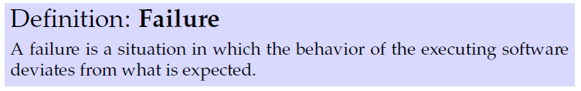
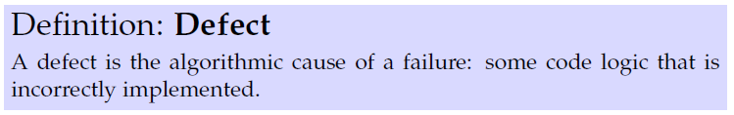
Terminology
Why are there failures in our running programs?
Or ‘Bug’

Slide 3
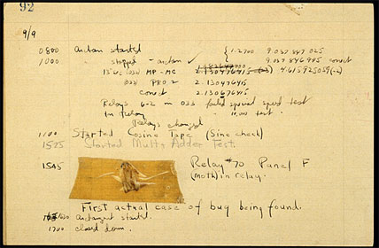
Worlds First Bug

Slide 4
Debugging
Some part of ‘input space’
trigger the Defect and leads
to a failure
  Software state is incorrect
As in
  The output is incorrect
    “does wrong things”
  System hangs
  System crashes

Slide 5
Debugging
Debugging is phased
  Reproduce the defect
    Find the exact input space/situation/context in which it appears
      “Ah, the reverse thrust of Airbus 320 cannot be engaged to stop the plane on the runway after landing, if one set of wheels hit the ground very smoothly…”
        [This is an actual bug, that stranded a plane outside the runway!]
  Find the ‘infection origin’
    Find the code that misbehaves and what state triggers it
    Understand the code ‘leading up to the defect’
      Why was the state that, leading up to the defect
  Write an automated test that reproduce the bug
  Fix it – rewrite that defective code

Slide 6
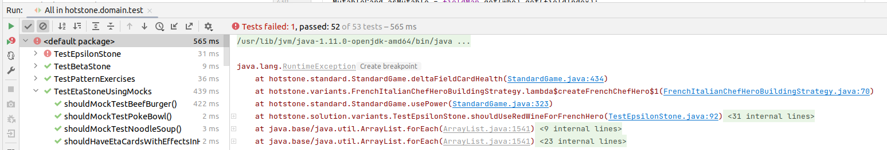
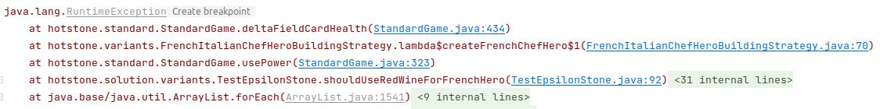
Stack Traces
Java + IntelliJ is a major help for modern day development as you get a Stack trace for exceptions!
  “the code lead up to the failure”
Example
Stack trace: The sequence of calls leading up to the exception begin thrown with line numbers!
Just click to “get there!”

Slide 7
Stack Traces
Java + IntelliJ is a major help for modern day development as you get a Stack trace for exceptions!
  “the code lead up to the failure”
Example
Stack trace: The sequence of calls leading up to the exception begin thrown with line numbers!
Just click to “get there!”

Slide 8
The Detective Work
Sometime the reason for the failure is “a long way” from the place where it manifests itself!
Sometimes failures can lurk in the dark for years
  If the ‘triggering state’ is encountered for the first time due to some on-the-surface change in another part of the system…
Detective work
  “Ok, failure because x was -1, but why it ever set to -1? It was passed by this method, which was called from this code, which was…”

Slide 9

Help The Detective Work
Often defects are because of incorrect assumptions
  State space is different from what I expected
Either
  Use the debugger
    Which has a steep learning curve in itself ☹
  Or the old workhorse… Add print statements
    System.out.println(“→ In playCard, index = “
    + index + “, list size = “ + myHand.size());
I have not started the debugger in years
  Take small steps saves a lot of debugging!
But note the → marker, allow search+remove afterwards!

Slide 10
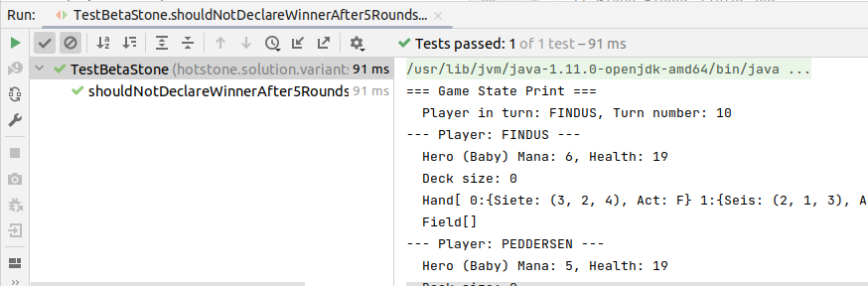
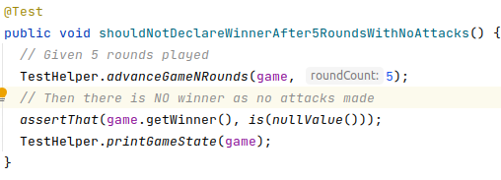
Helpers in HotStone
TestHelper.printGameState(game);

Slide 11
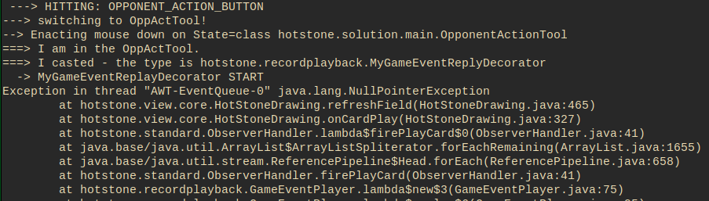
Example
While developing the GUI for HotStone, I encountered this failure…
(In the ‘good old days’ I would not get a stack trace)

Slide 12
Exception
Identifying the exact type of failure
  Here: some code did ‘object.method()’ and object == null ☹

Slide 13
StackTrace
It is the full call graph when the failure occurred
  refreshField was called by onCardPlay called by FirePlayCard called by forEachRemaining and so on…
  So the ‘object == null’ is within the refreshField of HotStoneDrawing

Slide 14
StackTrace
Moreover, since Java is running in its own execution environment (java virtual machine) it knows a lot about the executing code
  I get the exact spot in the code: line 465

Slide 15
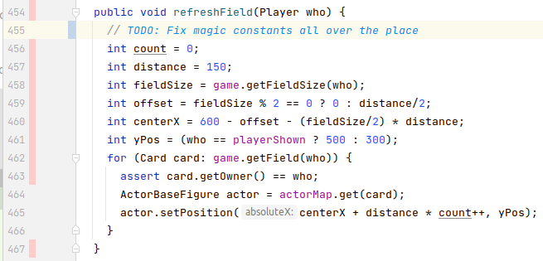
Which means I can…
Go to the source code and review to identify what went wrong…

Slide 16
Exercise
So what is the defect that has lead to the failure ?
  Remember: it was a null pointer exception (null reference)
Notes:
Actor == null

Slide 17
Lessons Learned
Development stops when a failure occurs – immediately
  You start debugging at once. Do not defects pile up!
It can be tempting to ‘just get that nice feature working and postpone debugging’
  Do Not. If defects pile up you simply loose focus. Keep Focus!
The almost-finished-sheet-music-editor warstory…

Slide 18
When Defect Found…
Sometimes you spend hours tracking down that damn defect…
When you find it: Heurica!
But you do not fix it, right?
  What do you do?
Exception: pure gui code.
Notes:
You create a test exposing the defect, THEN you fix it.

